Slide 1

AAA Medicare
Integration of Health and Insurance enterprises for hassle free experience

Slide 2

Problem
Tedious insurance approvals and claims process for patients availing medical consultations

Slide 3
Solution
To ensure Integration between Hospital and Insurance enterprises across the network to simplify consultations and test procedures.
Streamline Insurance payments across networks
Patients can avail medical services at any network of their choice without hassle

Slide 4
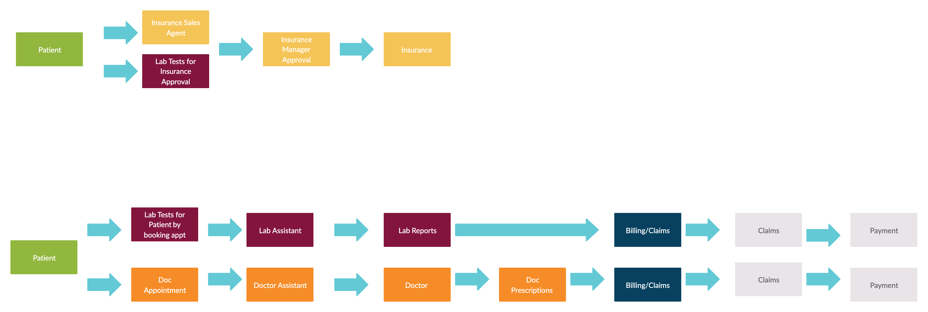
Workflow

Slide 5
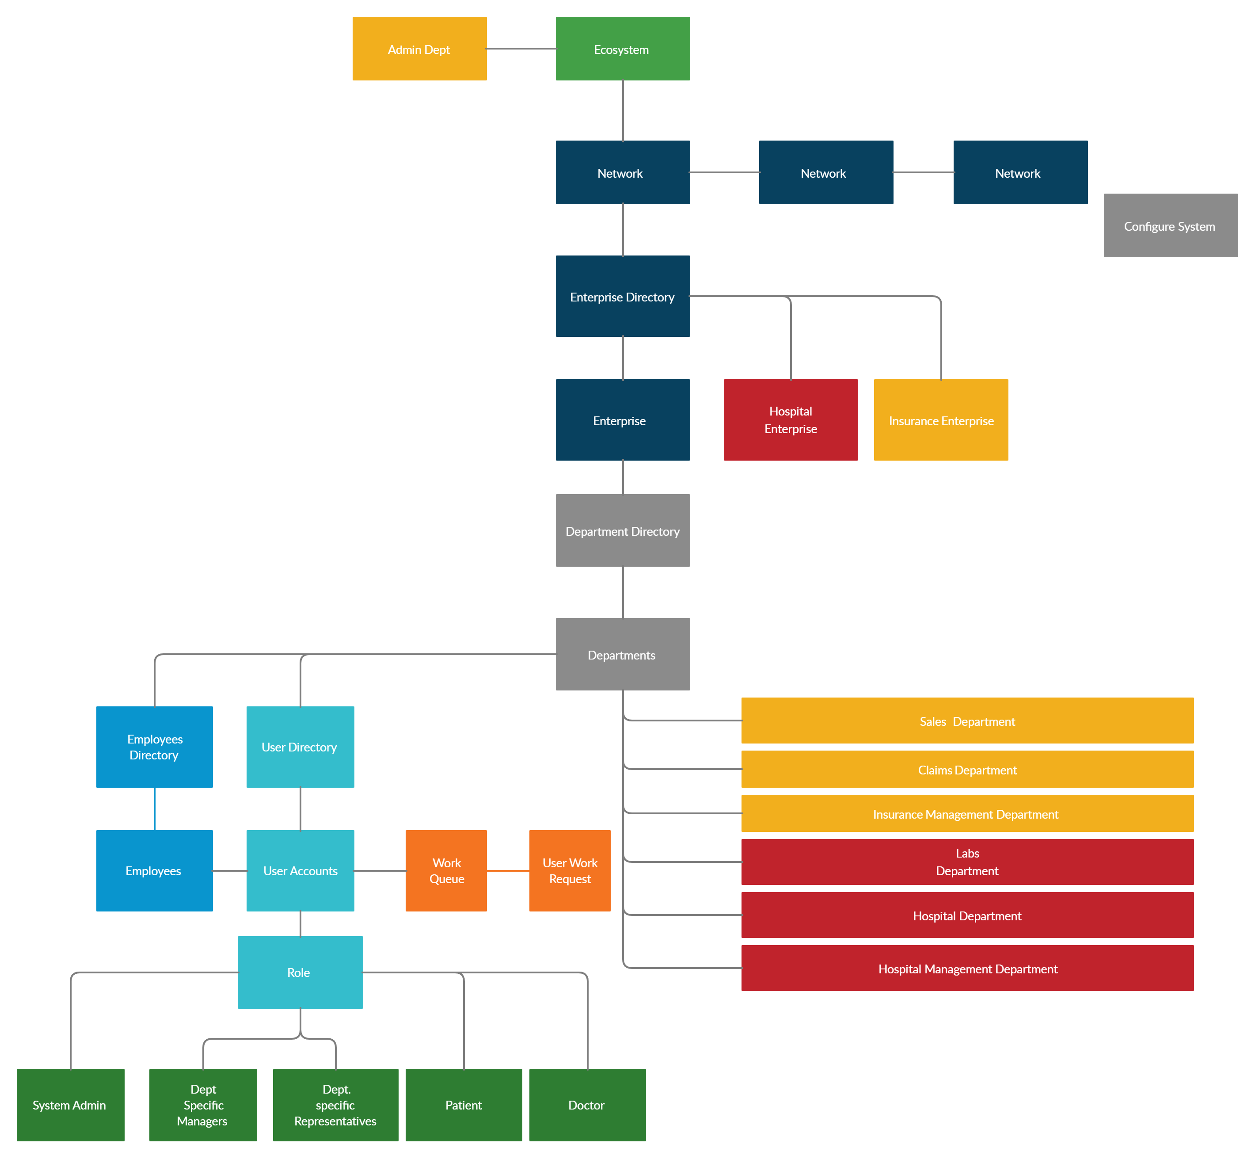
Model Diagram

Slide 6
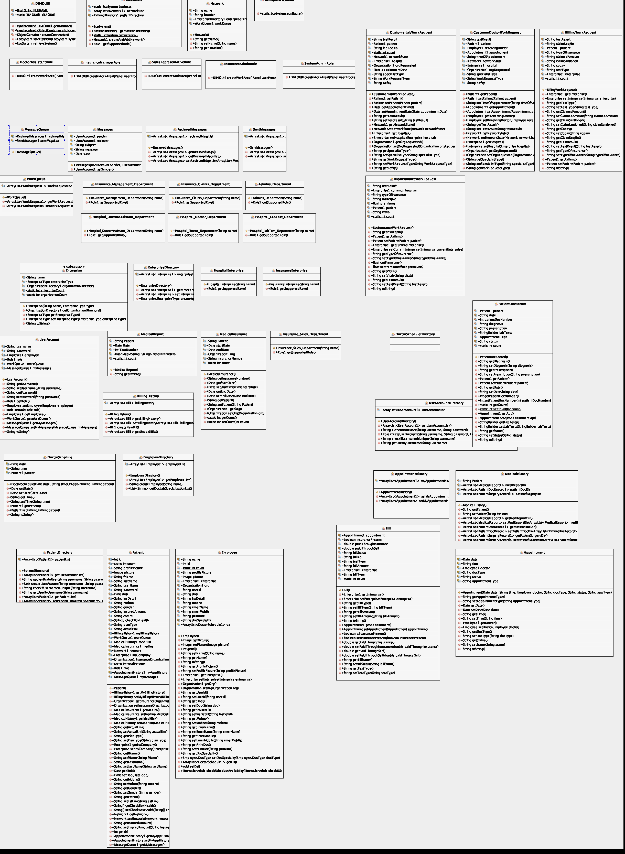
Class diagram

Slide 7
Roles and Capabilities
There are six employee roles and one Patient role
apart from Admin roles for their respective enterprises and one Super user.
Hospital Enterprise
Doctor Assistant – (DA) role – Approves Doctor appointments
Lab Assistant role – Receives Lab requests and updates Lab Reports
Doctor role – Processes Patient consultations
Insurance Enterprise
Sales Agent role - Receives buy insurance requests from customers. Processes them and sends them for approval
Claims Agent role – Receives claims request for processing (Patient consultations /Lab Test )
Manager role – Receives approval requests for buying insurance and Claim requests)
Patient role – Can take Doctor consultation and lab test appointments across network

Slide 8
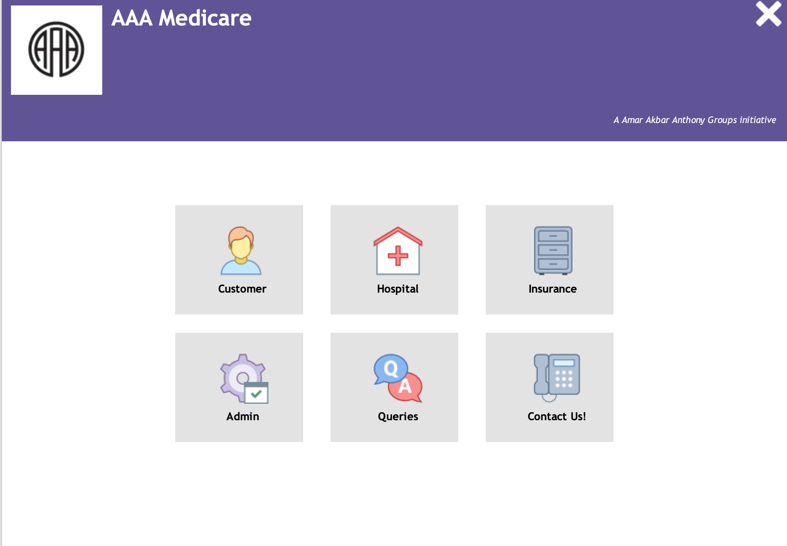
Screenshot of the Homepage

